Slide 1
Nachiket bhute
RIGHT ARM MEDIUM PACER
VIDARBHA SENIOR MEN’S TEAM
IN RANJI TROPHY SEASON 25-26

Slide 2
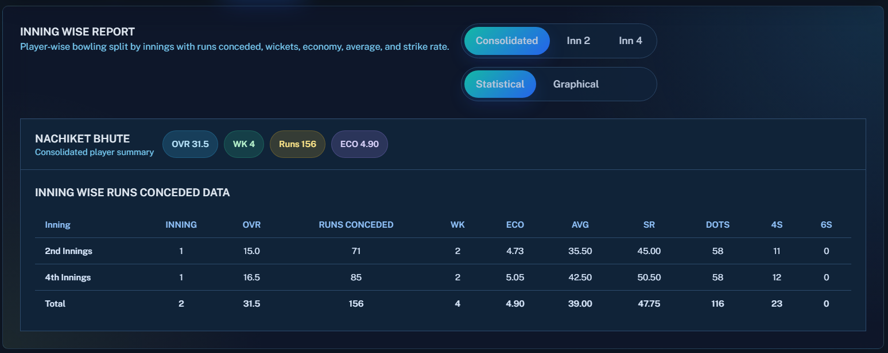
ROUND – 6 vs ANDHRA AT ANANTPUR.
BOWLING STATS

Slide 3
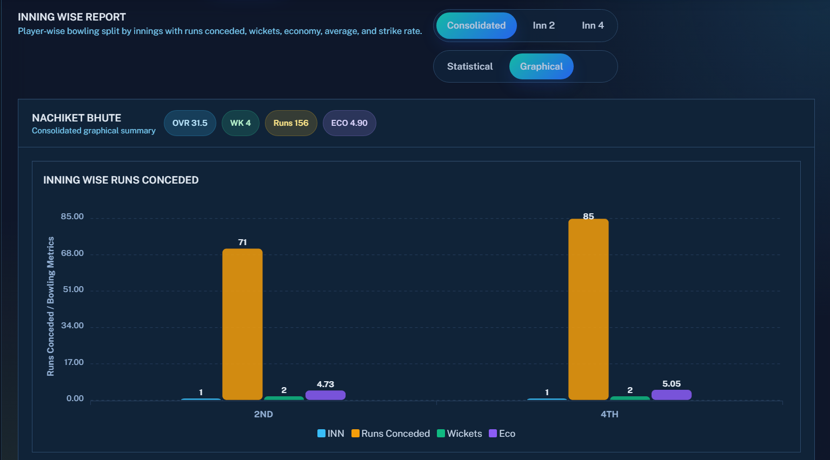
ROUND – 6 vs ANDHRA AT ANANTPUR.
BOWLING STATS GRAPHICAL REPRESENTATION

Slide 4
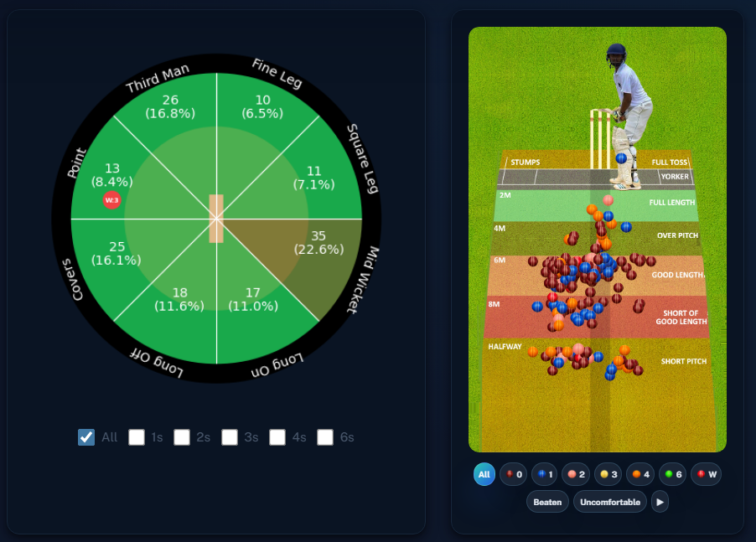
ROUND – 6 vs ANDHRA AT ANANTPUR.
OVER ALL

Slide 5
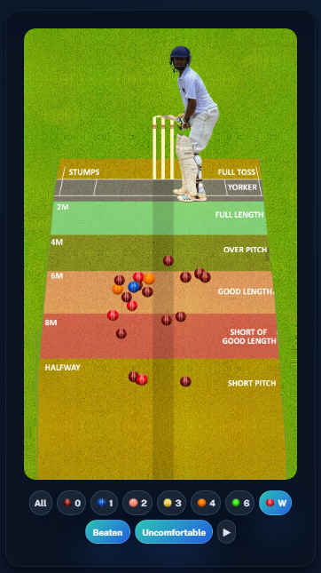
ROUND – 6 vs ANDHRA AT ANANTPUR.
BEATEN , UNCOMFORTABLE & DISMISSAL AREAS

Slide 6
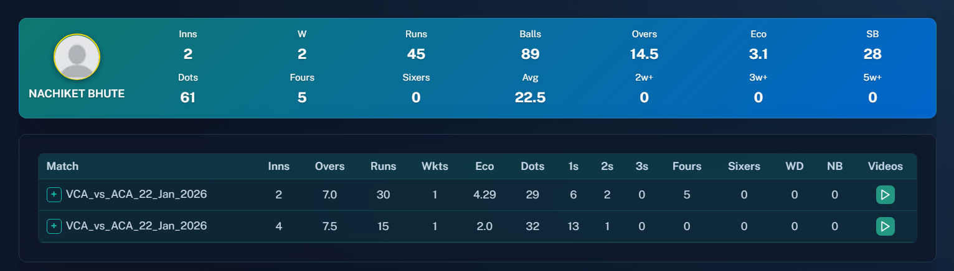
ROUND – 6 vs ANDHRA AT ANANTPUR.
PHASE WISE – ( 1 TO 20 OVERS )

Slide 7
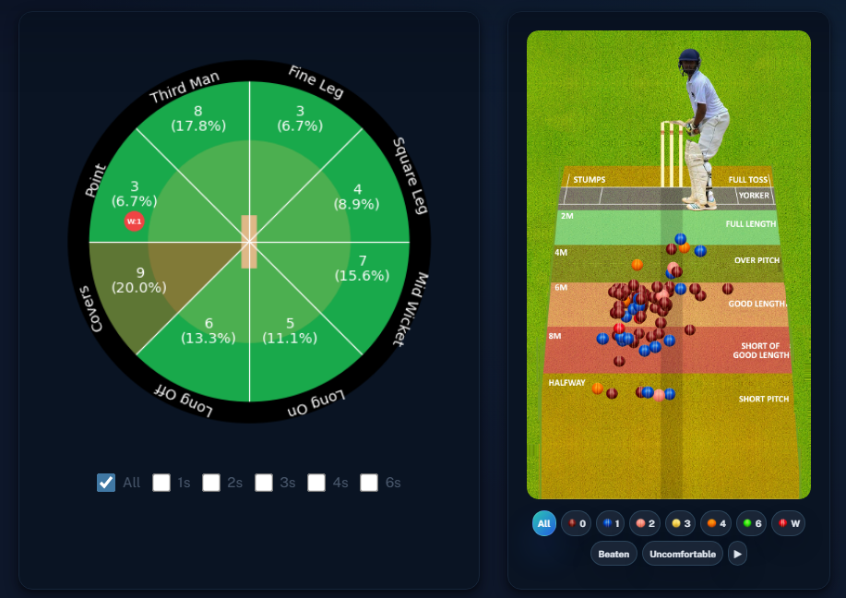
ROUND – 6 vs ANDHRA AT ANANTPUR.
PHASE WISE – ( 1 TO 20 OVERS )

Slide 8

ROUND – 6 vs ANDHRA AT ANANTPUR.
PHASE WISE – ( 21 TO 50 OVERS )

Slide 9
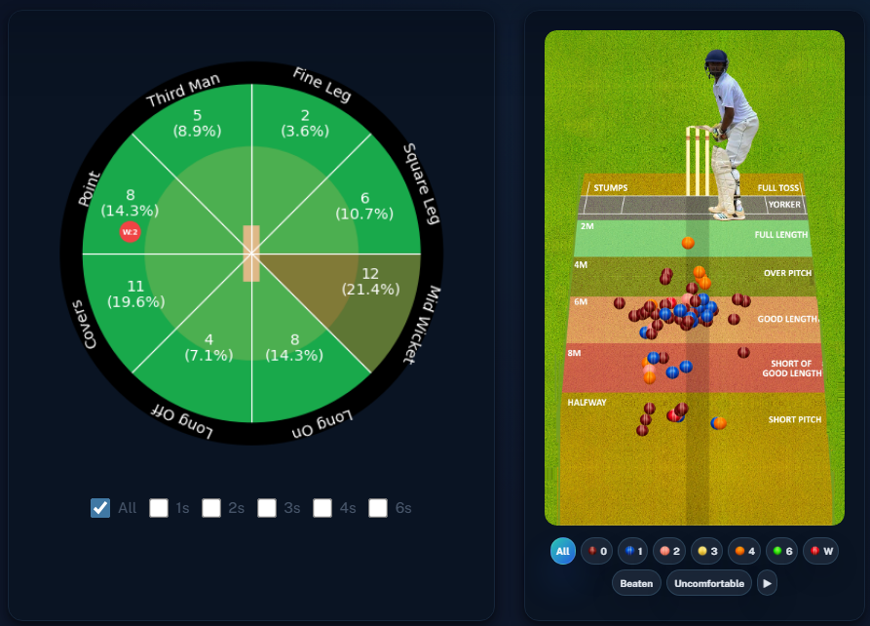
ROUND – 6 vs ANDHRA AT ANANTPUR.
PHASE WISE – ( 21 TO 50 OVERS )

Slide 10
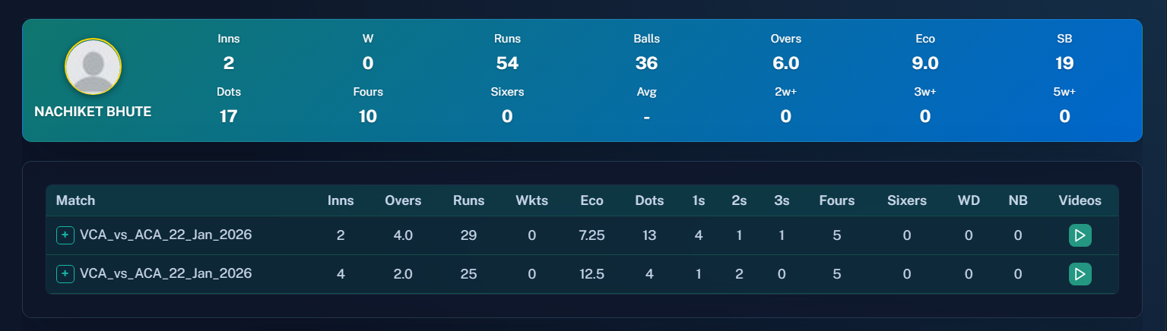
ROUND – 6 vs ANDHRA AT ANANTPUR.
PHASE WISE – ( 51 TO 80 OVERS )

Slide 11
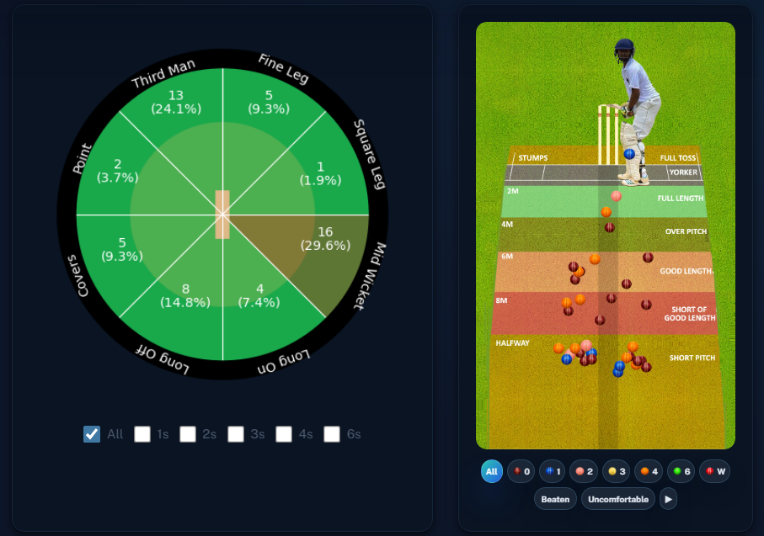
ROUND – 6 vs ANDHRA AT ANANTPUR.
PHASE WISE – ( 51 TO 80 OVERS )

Slide 12
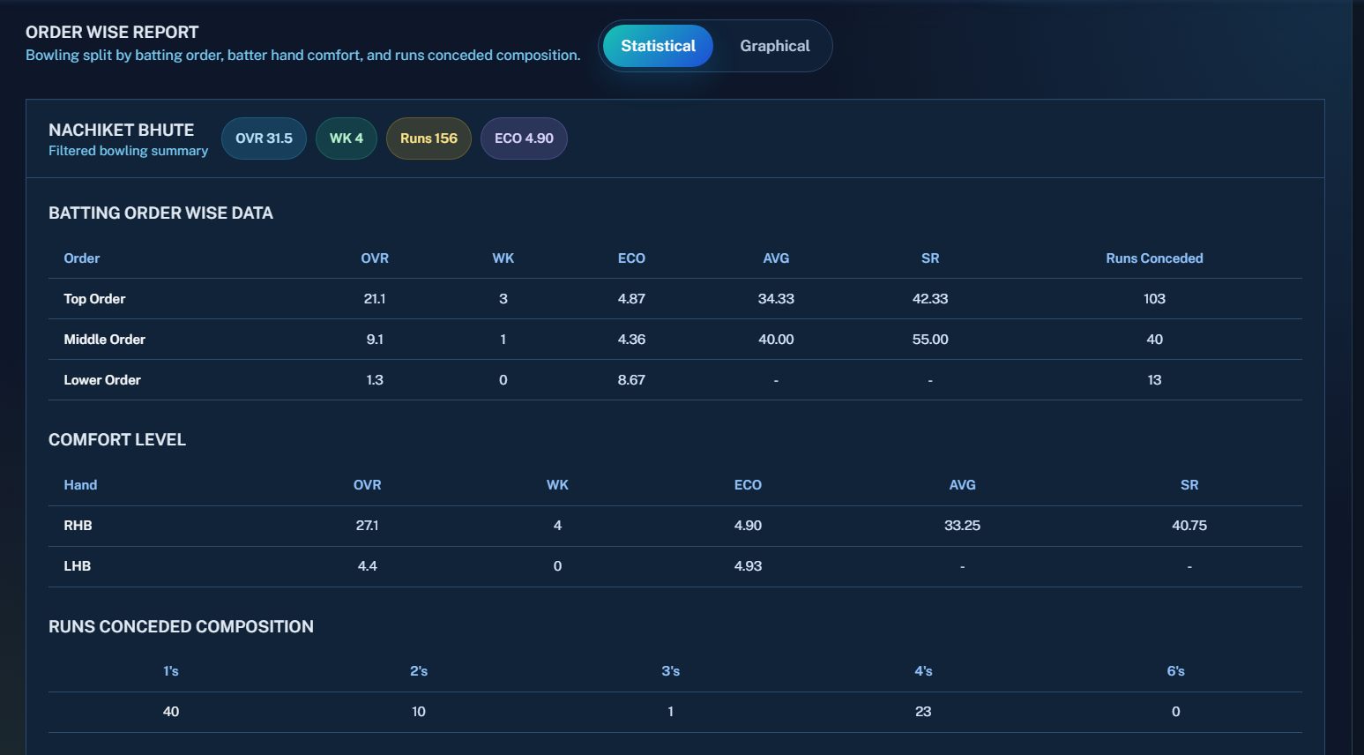
ROUND – 6 vs ANDHRA AT ANANTPUR.
ORDER WISE REPORT

Slide 13
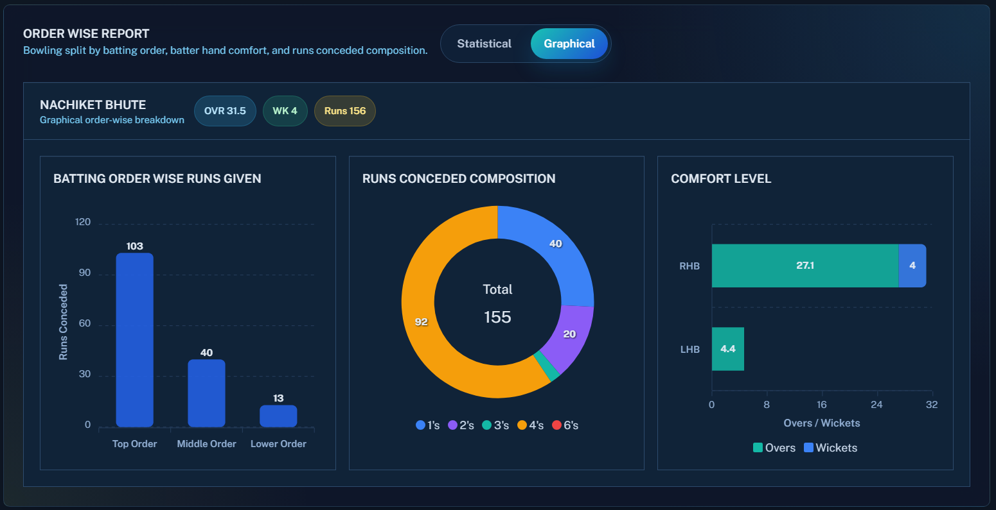
ROUND – 6 vs ANDHRA AT ANANTPUR.
ORDER WISE REPORT - GRAPHICAL

Slide 14
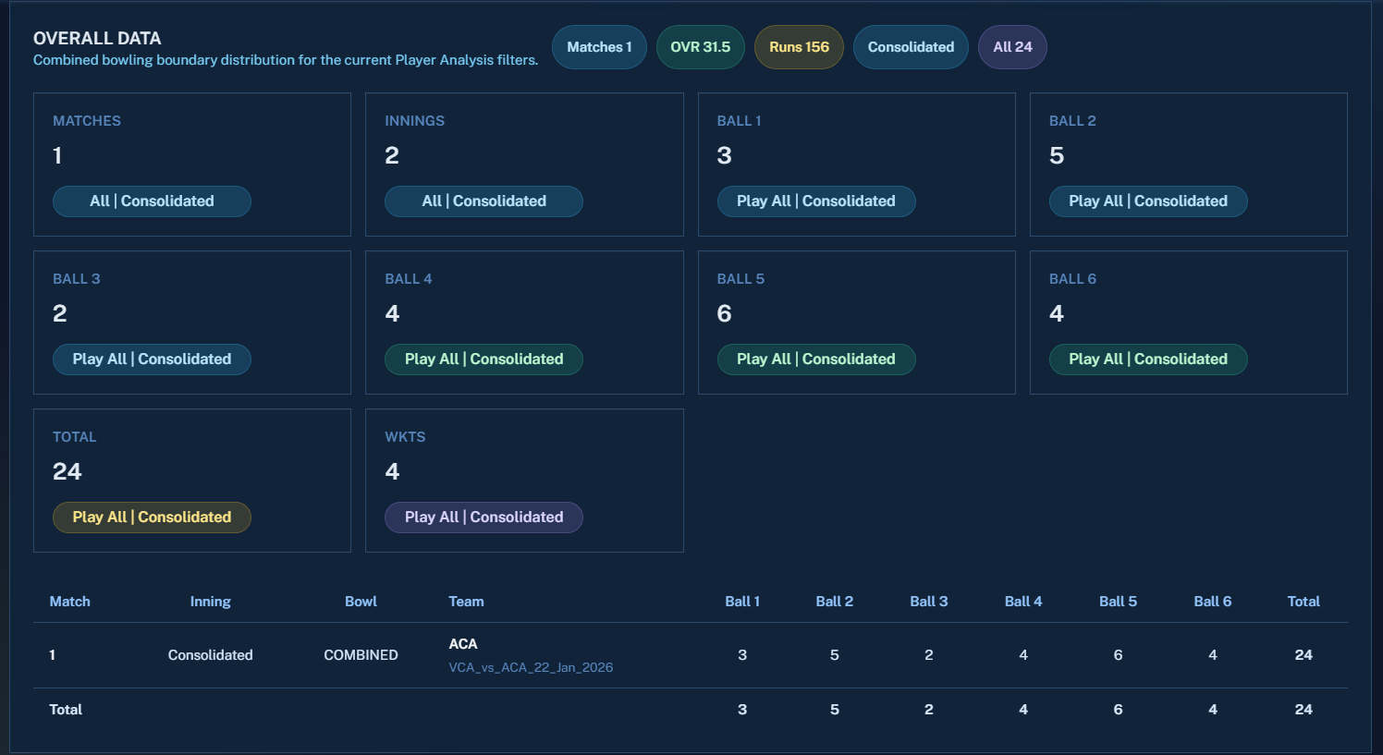
ROUND – 6 vs ANDHRA AT ANANTPUR.
BOUNDARY RATIO

Slide 15
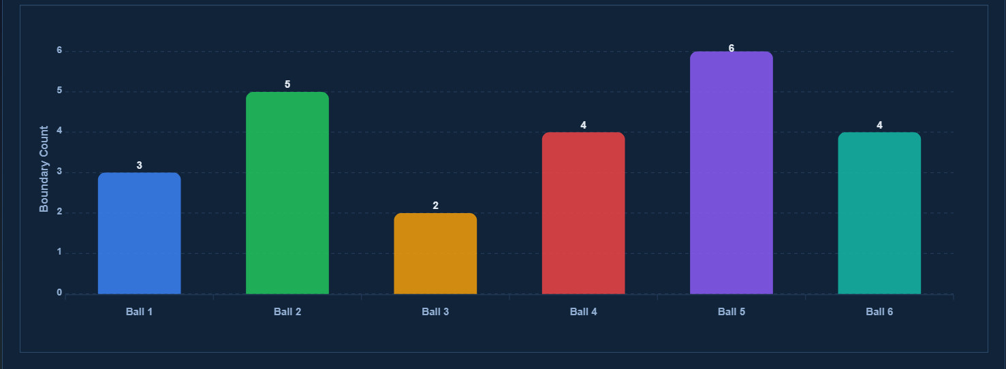
ROUND – 6 vs ANDHRA AT ANANTPUR.
BOUNDARY RATIO - GRAPHICAL

